Slide 1

--------------------------
E-COMMERCE APPLICATION ON CLOUD FOUNDRY
TEAM MEMBERS:
RAJAPRIYANKA R (au821321104028)
ALEENSHYLAJA K (au821321104001)
MADESHWARAN K (au821321104016)
SAIRA BEGAM S (au821321104031)
PREETHIKA V (au821321104025)

Slide 2
AGENDA
App – JS
Index JS
Navbar JS
User Authentication JS
Shopping Cart JS
Checkout Functionality JS
Order Query JS
Cart Features JS
Output

Slide 3
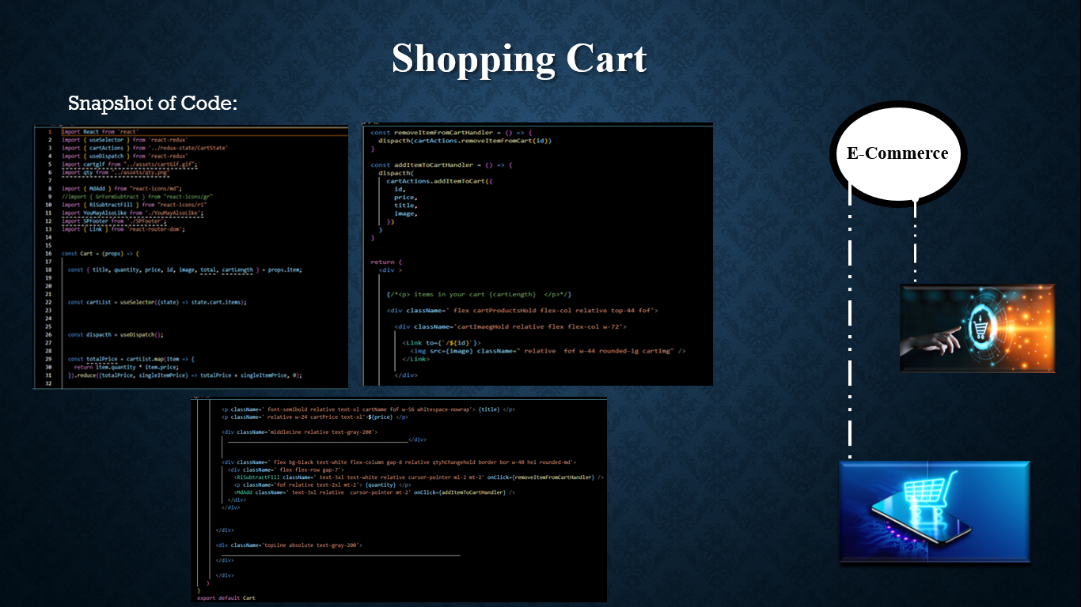
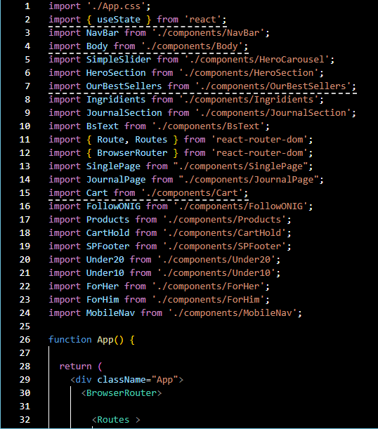
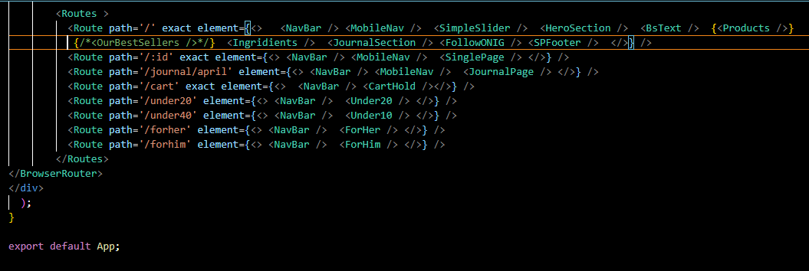
App JS
Snapshot of Code:

Slide 4
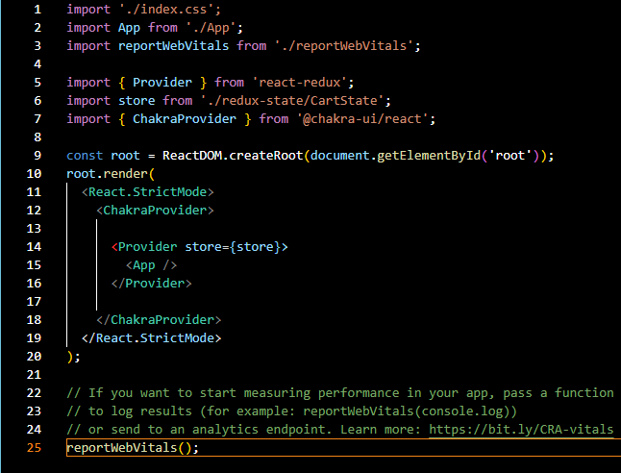
Index JS
Snapshot of Code:

Slide 5
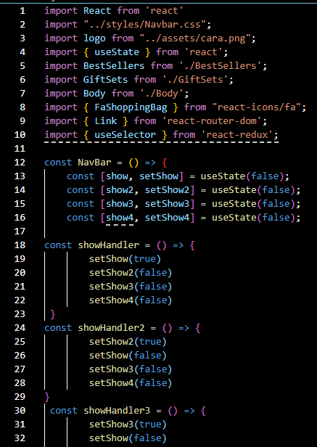
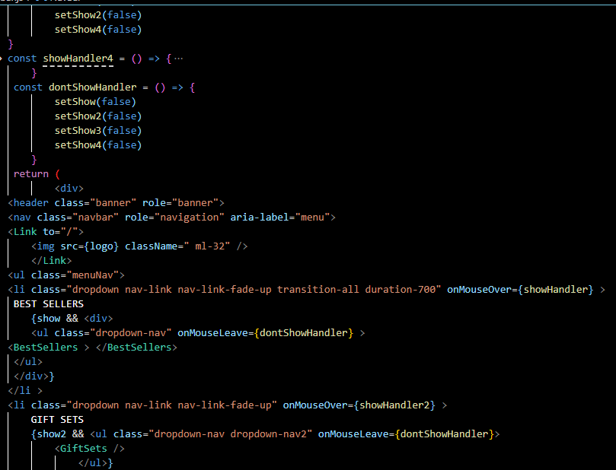
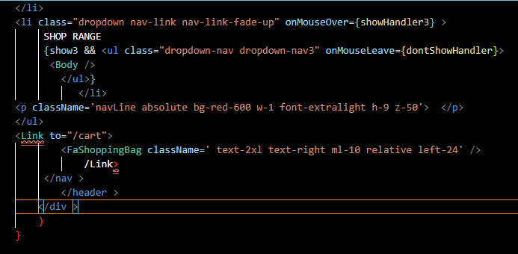
Navbar JS
Snapshot of Code:

Slide 6
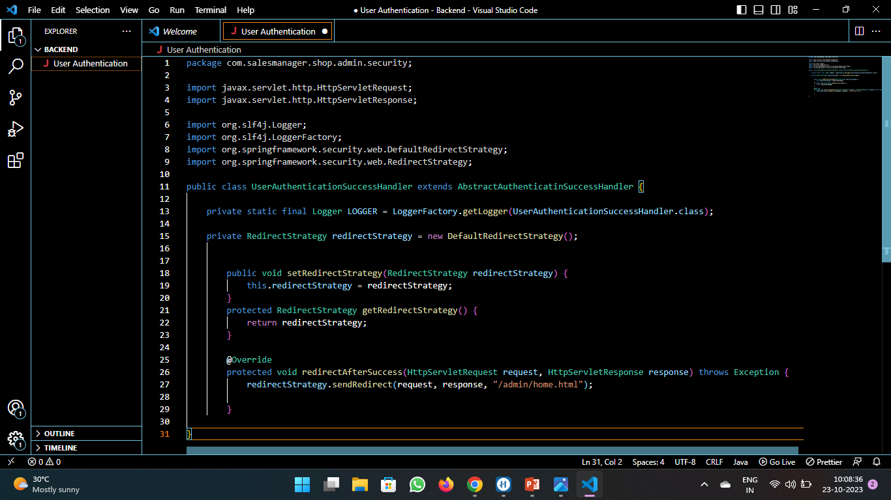


User Authentication JS
Snapshot of Code:
E-Commerce

Slide 7
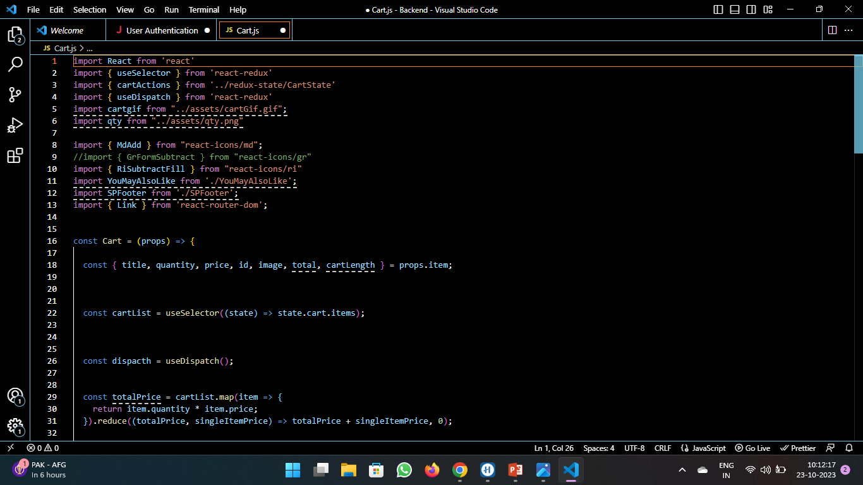
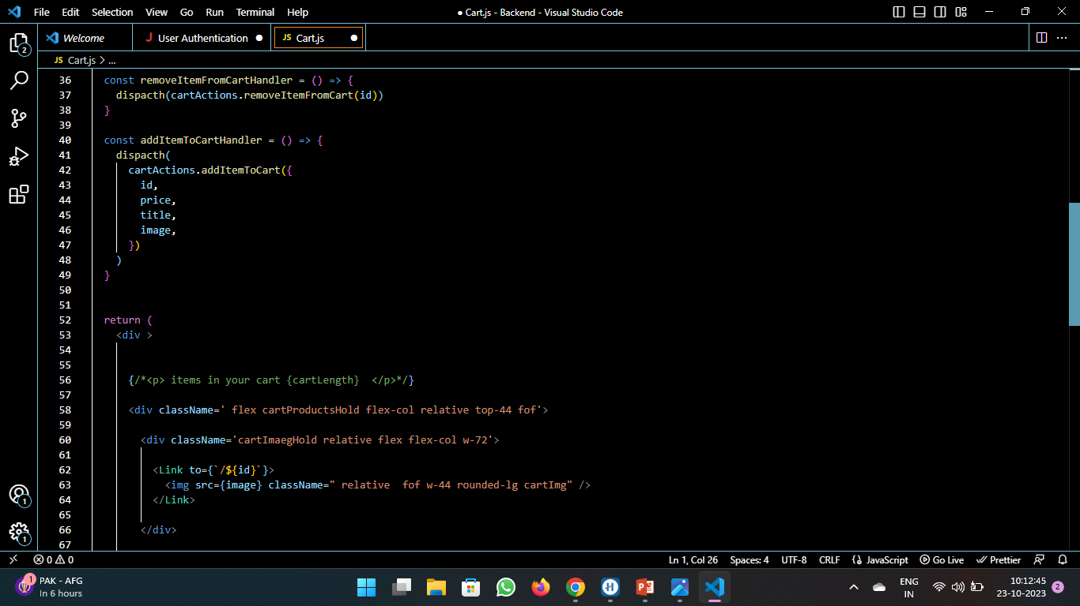
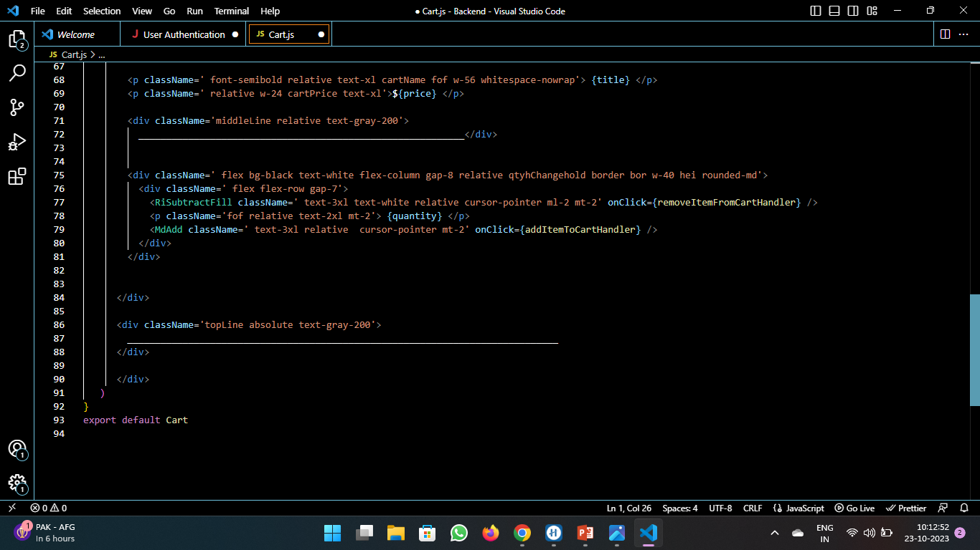
Shopping Cart JS
Snapshot of Code:
E-Commerce

Slide 8
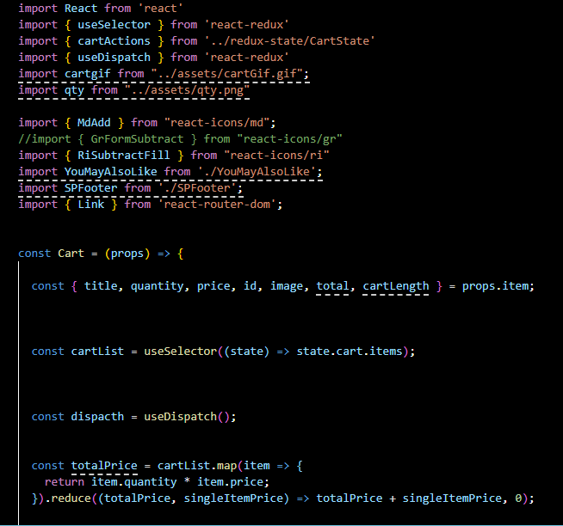
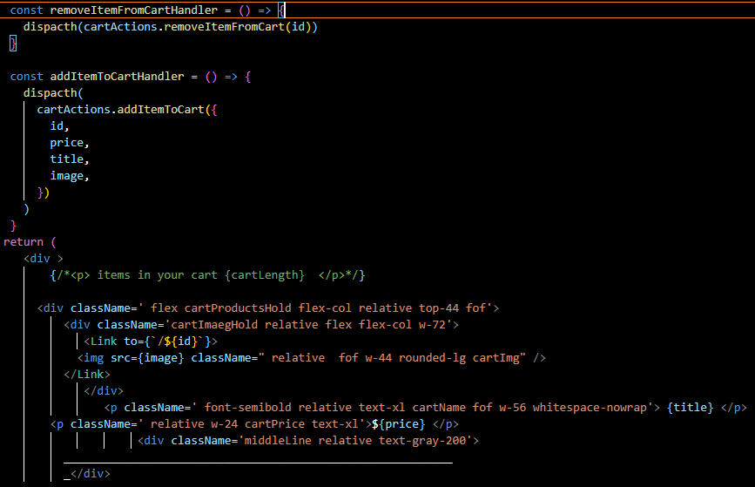
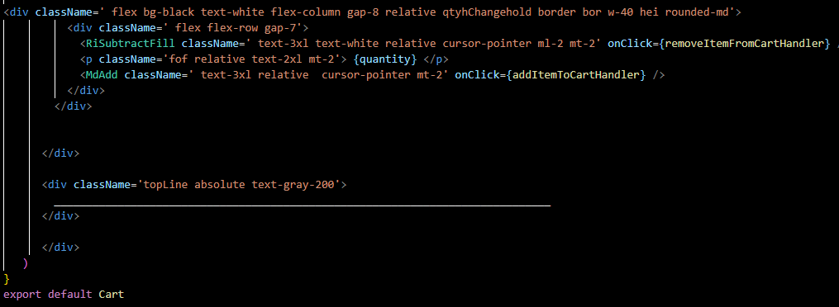
Checkout Functionality
Snapshot of Code:

Slide 9
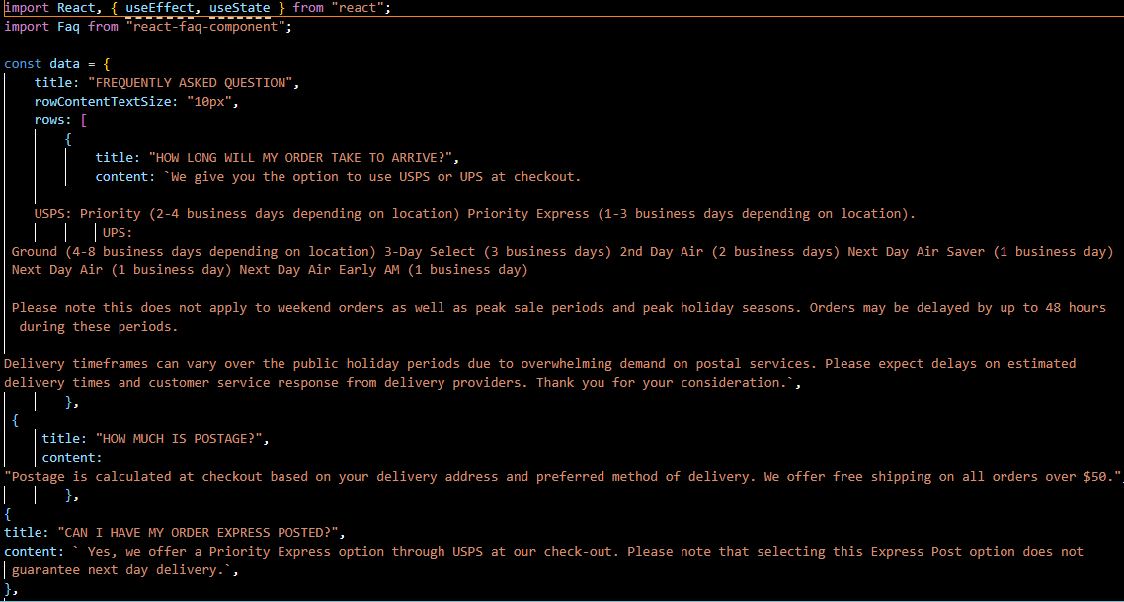
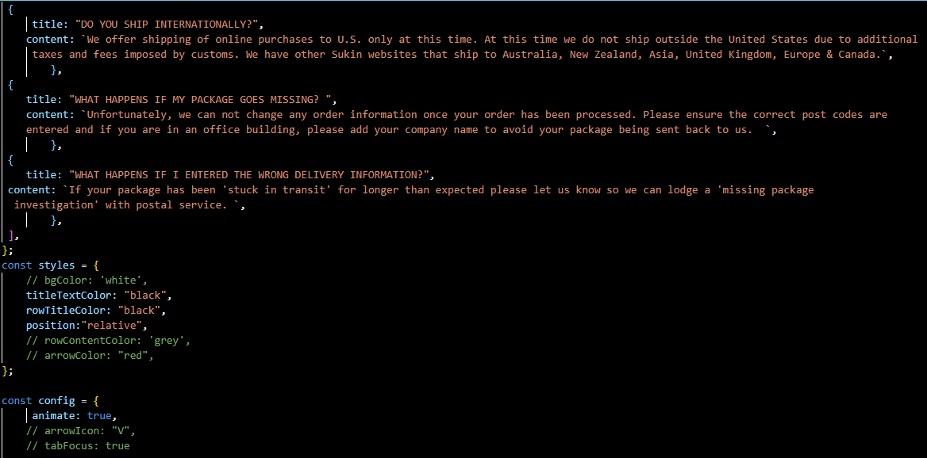
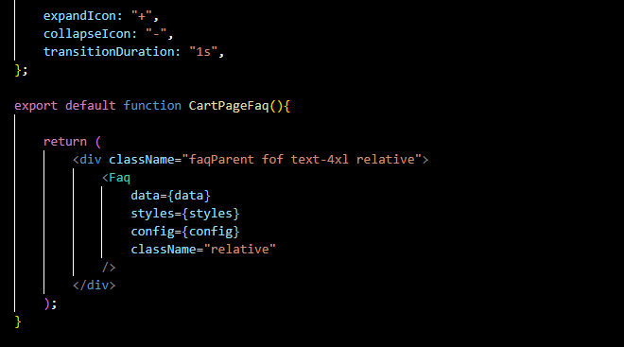
Order Query JSS
Snapshot of Code:

Slide 10
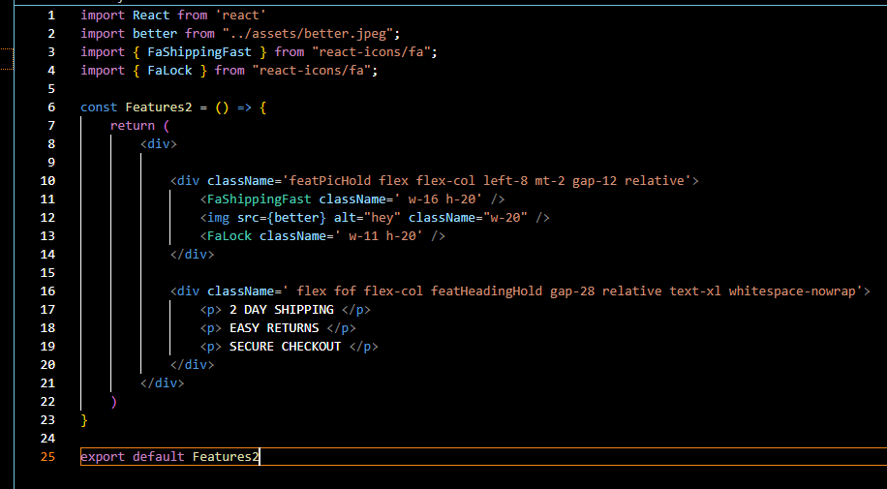
Cart Features JS
Snapshot of Code:

Slide 11
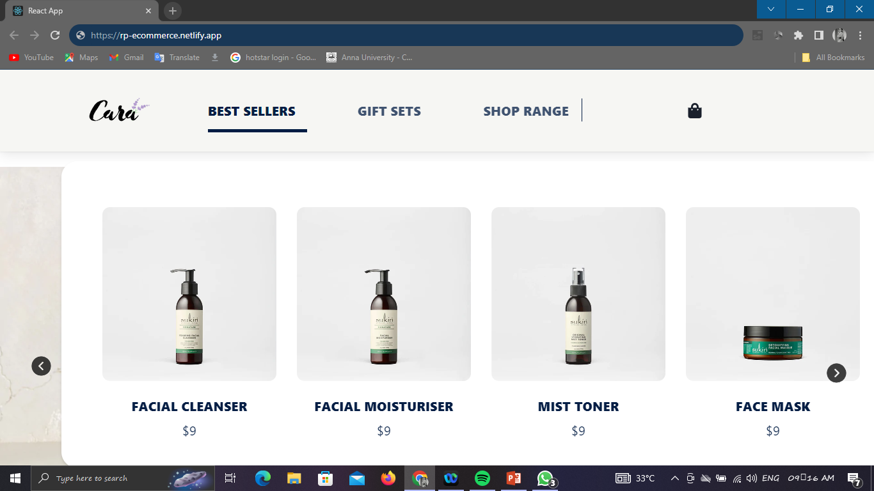
Output

